Slide 1
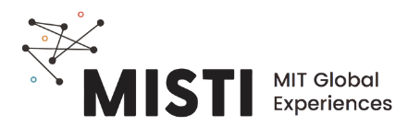
3D Printing & Bio-based PLA
Notes:
PLA: polylactic acid

Slide 2
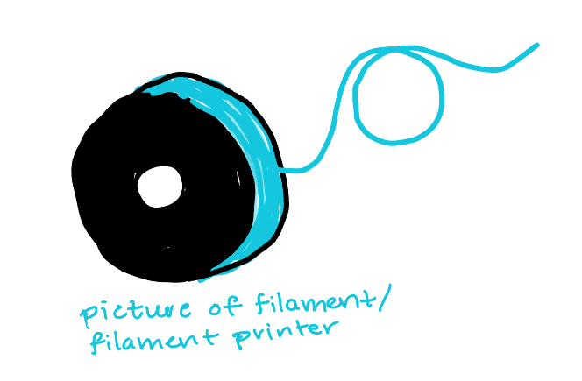
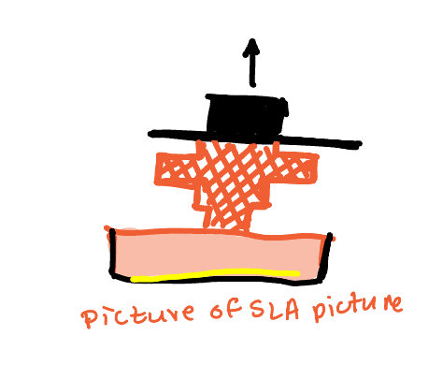
Types of 3D printing
Filament
Stereolithography (SLA)
Extrusion process
Less precise
More accessible
https://www.youtube.com/watch?v=P_DPHl_95MY
Light cure process
High precision
More technical
https://www.youtube.com/watch?v=kR7iDnrAxAU

Slide 3
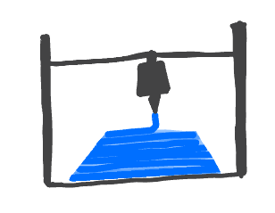
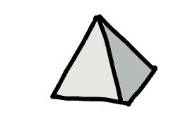
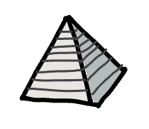
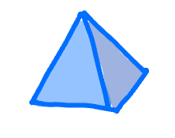
3D printing workflow
Computer-
aided design (CAD)
Slice and support (automated code)
Extrude or cure layer by layer
Final physical object
Why 3D print?
Direct design to fabrication
Build on demand
Personalization

Slide 4

3D printing design considerations
Layer by layer
Base layer needs to stick to platform
Overhangs are challenging- require support
Personalization

Slide 5
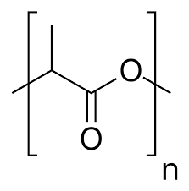
3D printing filament
Different polymers for different properties and applications
Poly(lactic acid) is easy to print and biodegradable
Melting temp is 170 - 180 °C
Other common filaments:
ABS: strong and long-lasting, smells bad during printing
PVA - water soluble supports

Slide 6
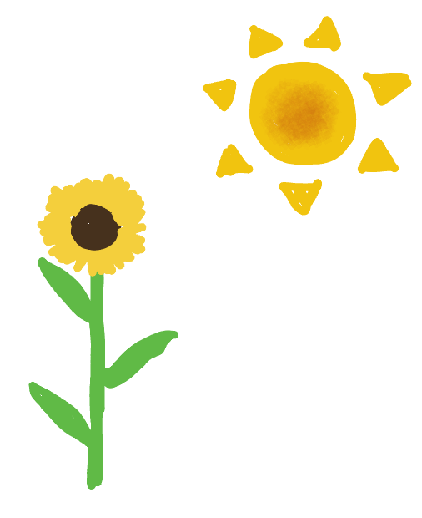
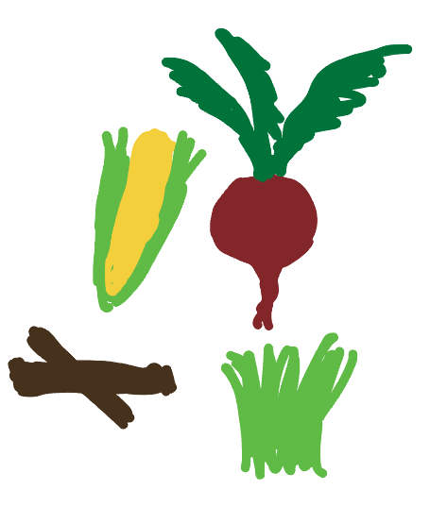
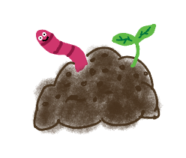

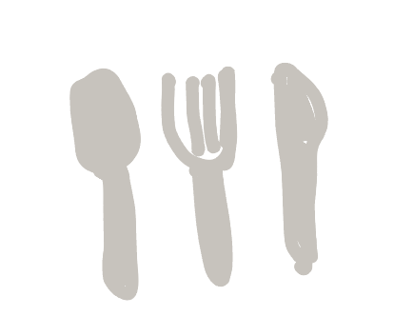
PLA Lifecycle
Photosynthesis absorbs CO₂
Raw materials
Fermentation
Polymerization
Start from corn, tapioca roots, or sugarcane
Biodegradation
Processing
Manufacturing

Slide 7
Pros and cons
Derived from plant, not oil-based materials
Thermoplastic- can be recycled
Biodegrades in 1-3 months in commercial composting
Requires land and water to grow plants
Low glass transition means products soften and plastic degrades
Takes significantly longer to degrade in the wild (10’s of years in some cases)

